Slide 1

Cyber Kill Chain
By
RAGILA V V

Slide 2
Introduction
A framework used to describe the stages of a cyberattack, from initial reconnaissance to achieving the attacker's objectives.
Understanding the Cyber Kill Chain helps organizations identify and mitigate cyber threats more effectively.

Slide 3
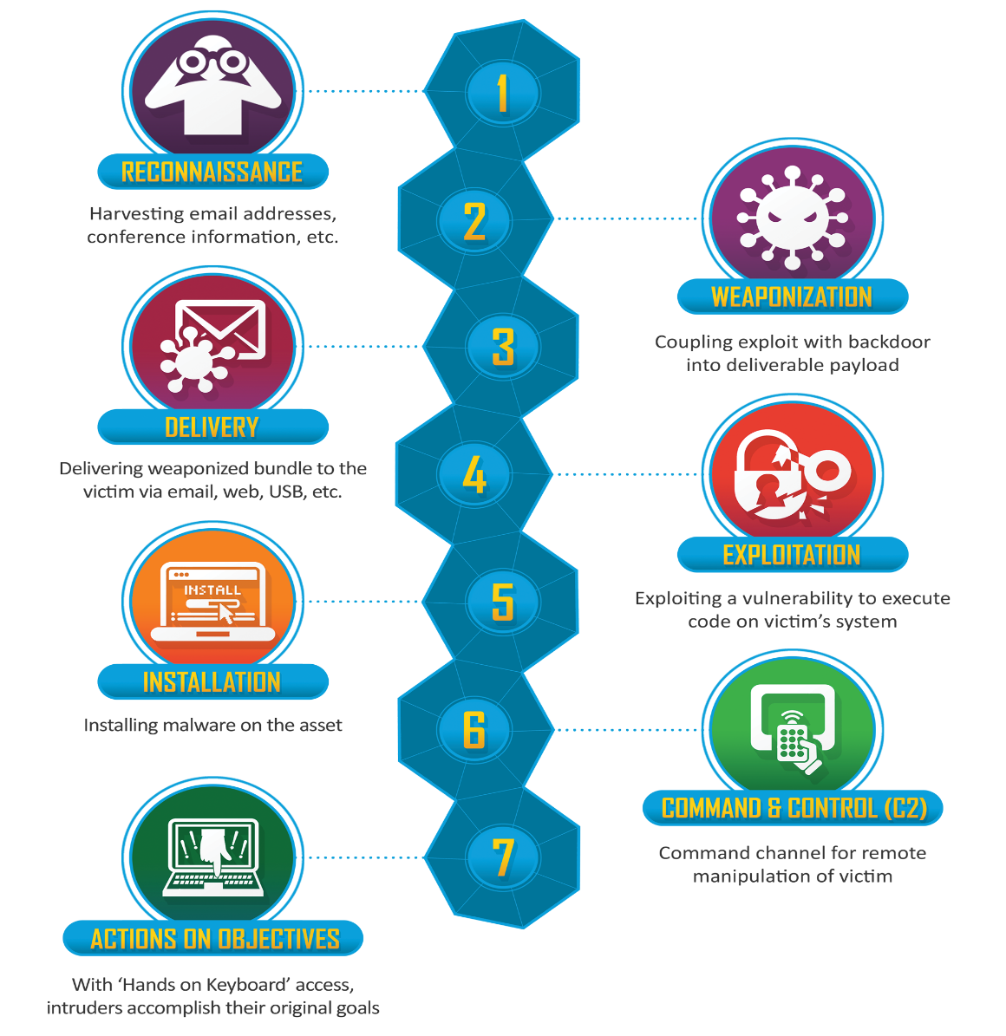
7 Phases of Cyber Kill Chain Process

Slide 4
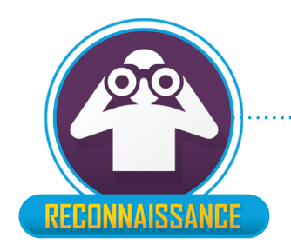
Phase 1 - Reconnaissance
The attacker gathers information about the target, including identifying potential vulnerabilities and entry points.
To gain insight into the target's infrastructure, network architecture, and potential weaknesses.

Slide 5
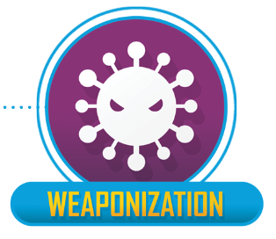
Phase 2 - Weaponization
The attacker creates or acquires malicious payloads, such as malware or exploits, tailored to exploit specific vulnerabilities.
To prepare the malicious payload for delivery to the target environment.

Slide 6

Phase 3 - Delivery
The attacker transmits the weaponized payload to the target, often using methods such as email phishing, malicious websites, or infected files.
To successfully deliver the payload to the target's systems or network.

Slide 7
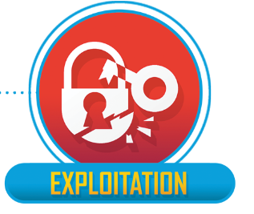
Phase 4 - Exploitation
The attacker exploits vulnerabilities in the target's systems or applications to execute the weaponized payload.
To gain unauthorized access or control over the target's systems.

Slide 8

Phase 5 - Installation
The attacker establishes a foothold within the target's environment by installing and executing the payload.
To maintain persistence and control over the compromised systems.

Slide 9
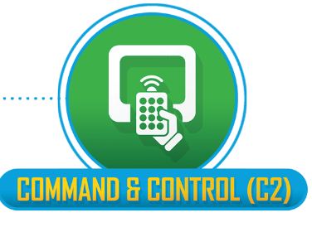
Phase 6 - Command and Control
The attacker establishes communication channels with the compromised systems to send commands and receive data.
To maintain control over the compromised systems and exfiltrate data or execute additional malicious actions.

Slide 10
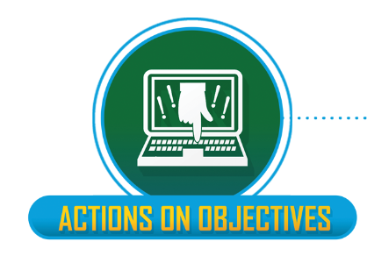
Phase 7 - Actions on Objectives
The attacker achieves their ultimate objectives, which could include data theft, system disruption, or financial gain.
To accomplish the goals of the cyberattack, often by stealing sensitive information or causing damage to the target's systems.

Slide 11
Conclusion and Defense Strategies
By understanding each phase of the Cyber Kill Chain, organizations can implement proactive defense strategies to detect, prevent, and respond to cyberattacks effectively.
Implementing threat intelligence, network segmentation, employee training, and robust cybersecurity measures can help organizations defend against cyber threats and mitigate the risks posed by each phase of the Cyber Kill Chain.

Slide 12
Thankyou

